Slide 1

Notes:
Notes:
Have this in presentation view. When you are ready to begin, advance to next slide. the Title 1 office video will automatically play

Slide 2

Notes:
This will play automatically while in presentation view.

Slide 3


Our School’s Title I Program
Principal
add_photo_alternate
School Logo
Placeholder
person
SARAH MOSLEY
Program Type
assignment
School-Wide
Notes:
Speaker Notes:
Welcome families and give introductions of school leadership as well as Title 1 lead teacher.

Slide 4
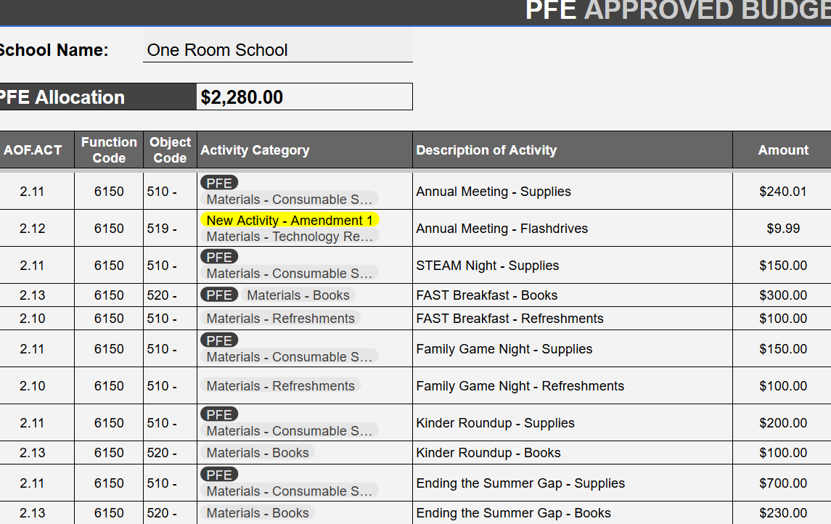
Our Title I Budget
add_photo_alternate
School Title 1 Budget
Placeholder
Notes:
Speaker Notes:
Discuss your school’s title 1 budget.
Note: Include a screenshot of the basic budget on slide. The PFE budget will be discussed in another section.

Slide 5

How We Use Title I Funds
Strategic allocation of resources to support student achievement and school communities
person_add
Additional Staff
menu_book
Instructional Materials
psychology
Professional Learning
track_changes
Intervention Programs
groups
Family Engagement
Notes:
Speaker Notes: Discuss how your school uses the title 1 funds to support any of the areas.
Note: Look at budgets for items that are paid for with Title 1 funds.

Slide 6
School Improvement Goals
How Title I Funding Supports Our Key Focus Areas
menu_book
{70% of students will be level 3 or higher} Title I Support
[ixl, Intervention teachers, ESY, EDI, istation]
calculate
{70% of students will score level 3 or higher}
Title I Support
[ixl, Reflex, Istation, intervention teachers, EDI (Jan), ESY (summer school)
🤝 e
{40% of parents will participate in Parent and Family Engagement events}
Title I Support
Annual Meeting, Family Game Night, STEAM Night, FAST breakfast, Kinder RoundUp, Ending Summer Gap)
Notes:
Speaker Notes: Discuss school improvement goals and customize to specific goals and activities in your school’s budget.
Note: Look at SIP

Slide 7
Parent & Family Engagement Plan
Building strong partnerships between school, home, and community
event
Events
Annual Title I Meeting, and school-wide community gatherings to share input.
Family Game Night - Dec.
STEAM night - Feb/Mar
FAST Breakfast (3rd-5th) - April
Kinder Round-Up - May
Ending Summer Gap - May
school
Trainings
Academic workshops and home learning strategy sessions to empower parents to support student success.
IXL, Reflex, YMHFA
groups
Family Nights
Interactive STEAM & Family Game night brings parents and children together for fun, hands-on learning experiences.
Notes:
Speaker Notes:
Discuss parent & family engagement plan and specific activities the school will have this year.
Note: Look at School’s PFE Plan and PFE budget.

Slide 8
Home-School Compact
A shared agreement outline for supporting student academic success
school
School Responsibilities
Title I Support
Committed to supporting student academic success, providing high-quality instruction, and maintaining open communication.
home
Parent Responsibilities
Title I Support
Committed to supporting learning at home, monitoring attendance, attending school events, and collaborating with teachers.
person
Student Responsibilities
Title I Support
Student committed for arriving prepared, completing homework, following school rules, and putting forth best academic effort.
Notes:
Speaker Notes:
Discuss each section of the home-school compact. Enter the information from your school’s current compact.
Note: Look at Compact.

Slide 9
Parent & Family Resources
Accessible tools and materials to support your child's learning journey
auto_stories
Resource Area
T1 ROOM @ LITTLE SCHOOL
Visit our dedicated Parent & Family Resource Area and browse the resources available to support learning at home.
category
Available Materials
Educational Tools
Explore books, hands-on learning games and interactive tools designed to reinforce classroom skills.
assignment_turned_in
Checkout Process
Borrow Guidelines
Learn about our simple, convenient process to borrow items for home use to support ongoing learning objectives.
Notes:
Speaker Notes:
Discuss parent the Parent and Family Resource notebook(including that it is located in the front office) and the school’s resource area(where it is located in the school and check out process).
Note: Have items from the resource area on display for the families to view, and check out if possible. If items can not be brought in, have pictures on presentation of items.

Slide 10
Questions
Thank you for partnering with us!
person
Principal
SARAH MOSLEY
S.MOSLEY@ORSH.NET
352-727-4373 BIG
352-376-4014 LITTLE
school
Title I Lead Teacher
ASHLEY BARNES
A.BARNES@ORSH.NET
Notes:
Speaker Notes:
Field any questions, then share contact information for Admin and Lead Teacher

Slide 11
Questions
Thank you for partnering with us!
qr_coe_2
Parent Survey
Please fill out the parent survey and give me your feedback.
Notes:
Speaker Notes:
Have attendees complete parent survey(print or digital version).

